Slide 1

Predictive Analytics in Sports Gambling
DSC 630 Predictive Analytics
Final Project Michael Loos
Notes:
We designed this template so that each member of the project team has a set of slides with its own theme. Members, here’s how you add a new slide to just your set:
Mark where you want to add the slide: Select an existing one in the Thumbnails pane, click the New Slide button, then choose a layout. The new slide gets the same theme as the other slides in your set.
Careful! Don’t annoy your fellow presenters by accidentally changing their themes. That can happen if you choose a different theme from the Design tab, which changes all of the slides in the presentation to that look.

Slide 2
Agenda / Topics
Background
Project Description
Project Methodology
Key Findings/Results
Conclusion

Slide 3
Background
Sports gambling had long been illegal nationally
Supreme Court ruled The Professional and Amateur Sports Protection Act (PASPA) unconstitutional on May 14, 2018
Legalization occurring state by state
19 states as of Feb 4, 2021
Estimated $150 billion per year

Slide 4
Problem Statement
Both sportsbooks and gamblers seek to gain an edge to correctly predict outcome of games
Bettors need to win 52.4% of bets to profit
At standard odds of –110
Common types of bets
Point Spread: Betting on team to win or lose by set amounts
Point Total: Betting on total points scored in a game
Money Line: Betting on team to win

Slide 5
Proposal
Use historical college football data to train predictive models to predict the scores for each game
Model results would enable to us to predict the winner of each game, results against the spread, and point total

Slide 6
Data
Source: CollegeFootballData.com
2019 college football season
Variables include:
Week
Teams
Points scored
Spread
Over/Under
Team statistics
Calculated variables

Slide 7
Tools
Python
Data gathering
Data cleaning
Data structuring
Modeling
Neural Network
R Studio
Exploratory Data Analysis (EDA)
Modeling
Logistic Regression
Linear Regression

Slide 8
Data Wrangling
CollegeFootballData.com contains
Game data
Drive data
Team weekly statistics
Team recruiting data
Spread data
Data downloaded as csv files
Files joined together to create master file
Create custom variables
Win/Lose
Cover/Did not cover
Moving averages

Slide 9
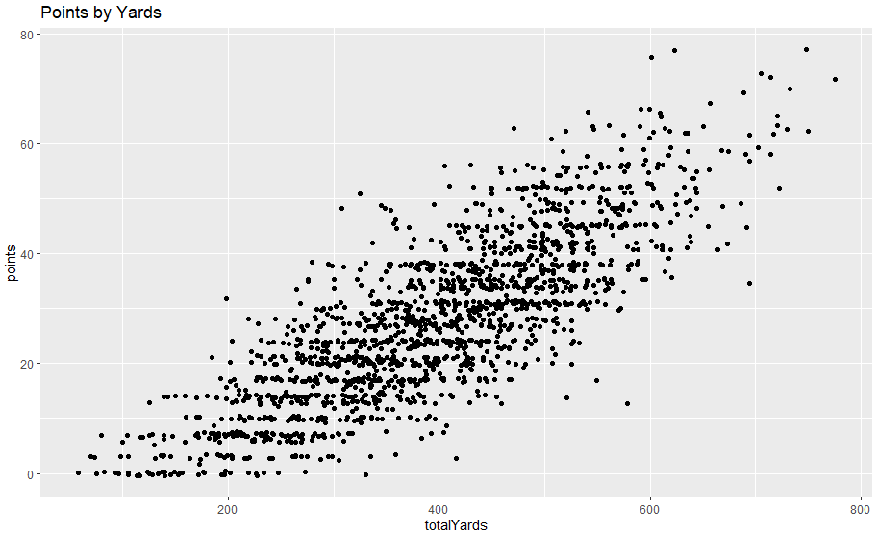
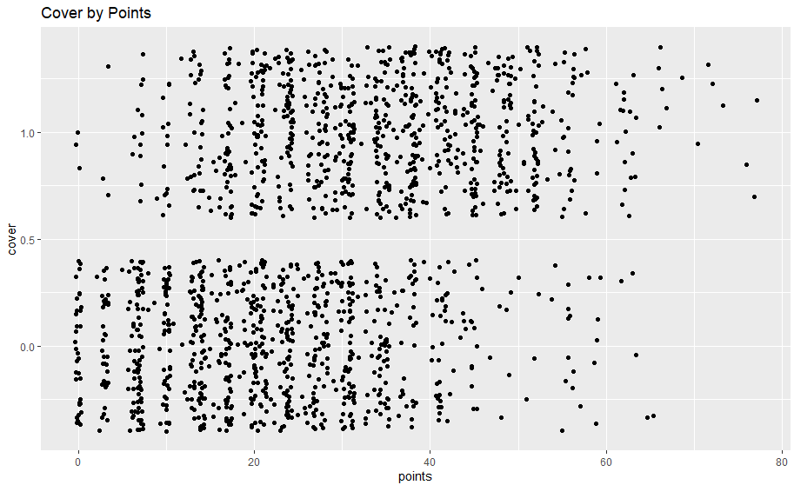
EDA
Discover variables of interest
Determine variables correlated with points scored
Total yards and points have strong correlation: 0.8066
Total yards has weaker correlation with covering the spread: 0.300

Slide 10
Logistic Regression
Use logistic regression to predict winner and loser of each game
This should be an easier prediction to help start model
Backward looking logistic model using current game statistics to predict outcome of game
Correctly predicts winner 79% of time
Forward looking logistic model using previous game statistics to predict outcome of current game
Correctly predicts winner 64.8% of time
Accuracy drops to 57.8% of time for close spreads, when spread is +-3

Slide 11
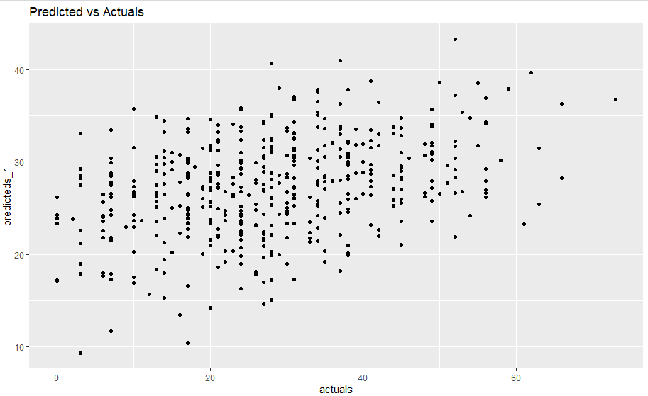
Linear Regression
Use linear regression to predict score for each team for each game
Feature variables included moving averages of points scored, total yards, points given up by opposing team and yards given up by opposing team
Tended to predict higher scores
48.29% accuracy against the spread

Slide 12
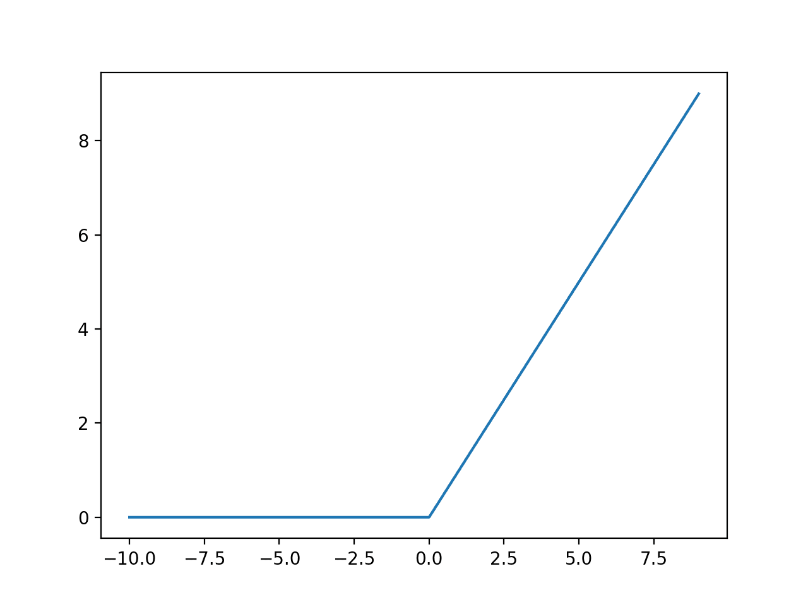
Sklearn Neural Network
Use Sklearn MLPRegressor to predict score for each team for each game
5 hidden layers of 200, 200, 100, 100, and 100 nodes, respectively
Relu activation
Results
Moneyline winner: 49.39%
Spread: 52.13%
Total (over/under): 53.96%

Slide 13
Keras Neural Network
Use Keras Sequential to predict score for each team for each game
2 hidden layers of 500 and 50 nodes, respectively
Relu activation
Results
Moneyline winner: 48.48%
Spread: 52.13%
Total (over/under): 54.57%

Slide 14
Challenges
Data
Difficult to wrangle data, particularly for opponent’s opponents
Time Leak
Variables that predict outcome of current games do not predict future games as well
Difficulty of predict spread
Much more difficult to predict against spread than outcome of game
Accuracy of predicting outcome of spreads (52.1%) is greater than random chance but lower than needed accuracy against the spread (52.4%) to be profitable

Slide 15
Conclusion
Logistic regression model performs better than random guess
64.8% accuracy
Would not necessarily be profitable
Linear regression model performs poorly
Less than 50% accuracy
Both neural networks would about break even against the spread, but would be profitable against the total

